Slide 1
Design the Authentication layer with AWS Cognito and Authorization layer with RBAC module

Slide 2
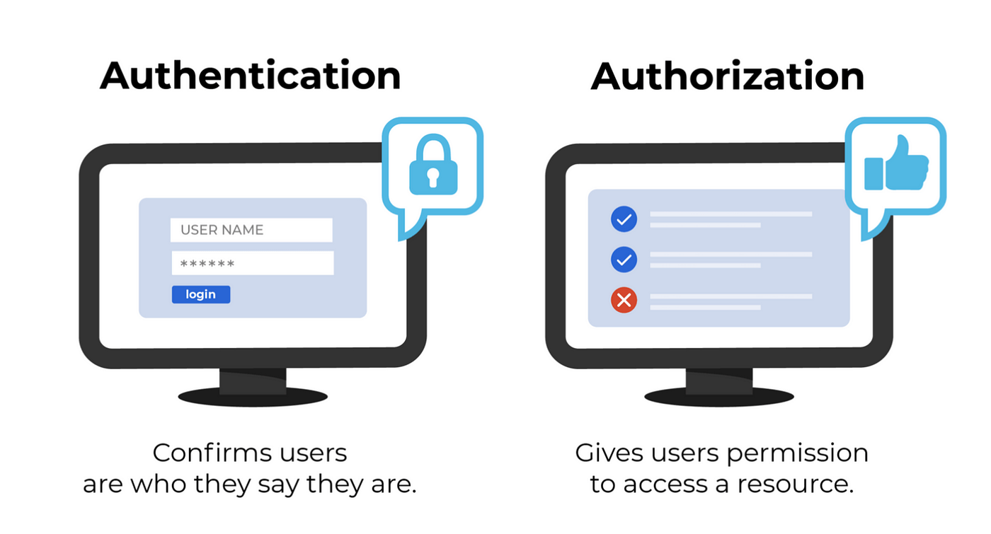
Authentication vs. Authorization
Authentication : Authentication verifies a user's identity
Authorization: Authorization determines the user's level of access and grants access based on that level

Slide 3
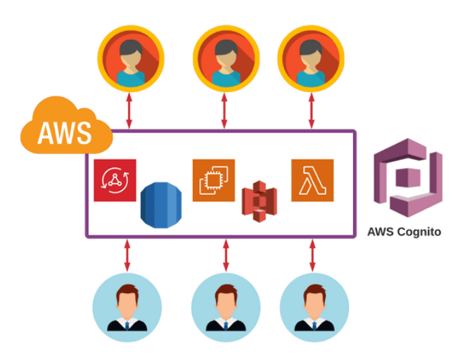
AWS Cognito
AWS Cognito is a service provided by Amazon Web Services (AWS) that handles user authentication, authorization, and user management for web and mobile applications. It enables developers to add sign-up, sign-in, and access control to their applications quickly and securely.

Slide 4
Key Benefits of AWS Cognito:
User Authentication
User Management
Scalability
Security
Customization
Social and Enterprise Identity Federation
Seamless Integration
Main Components:
User pool
Identity pool

Slide 5
Cognito User pool
An Amazon Cognito user pool is a user directory. With a user pool, your users can sign in to your web or mobile app through Amazon Cognito, or federate through a third-party IdP. Federated and local users have a user profile in your user pool.

Slide 6
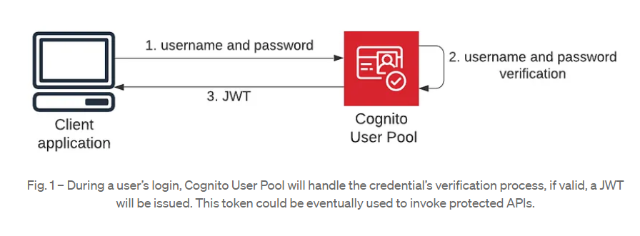
Cognito User pool

Slide 7
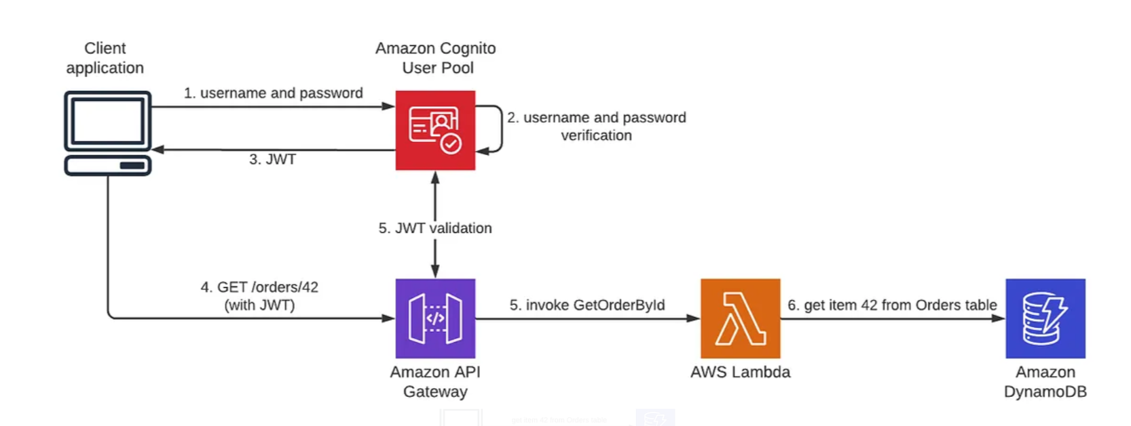
Authenticate with User Pool

Slide 8

Role Based Access Control
RBAC is a method for controlling user access to systems based on user roles and permissions.
It allows us to improve our security posture, comply with relevant regulations, and reduce operational overhead.

Slide 9
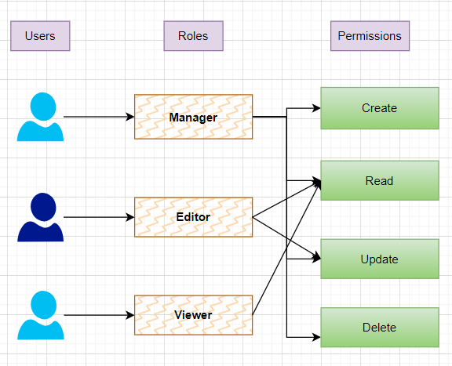
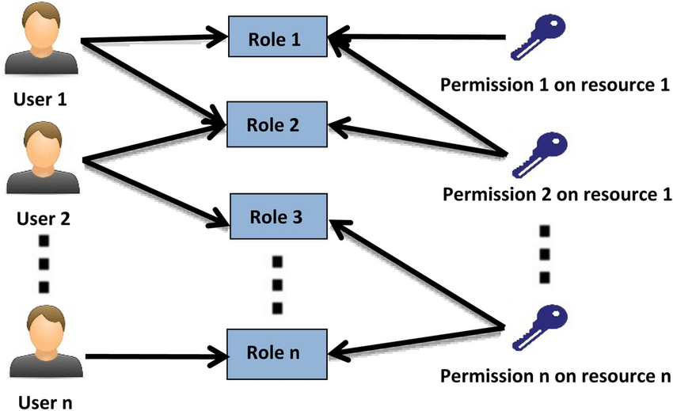
Role Based Access Control

Slide 10
Thank You!

